Slide 1






^{Welcome to}
^{92nd} LCA Discussion Forum
AI in LCA: Innovations, Applications, and Challenges
WLAN
Network: Diskussionsforum
Password: DF-LCA-92
Sponsors 2026

Slide 2
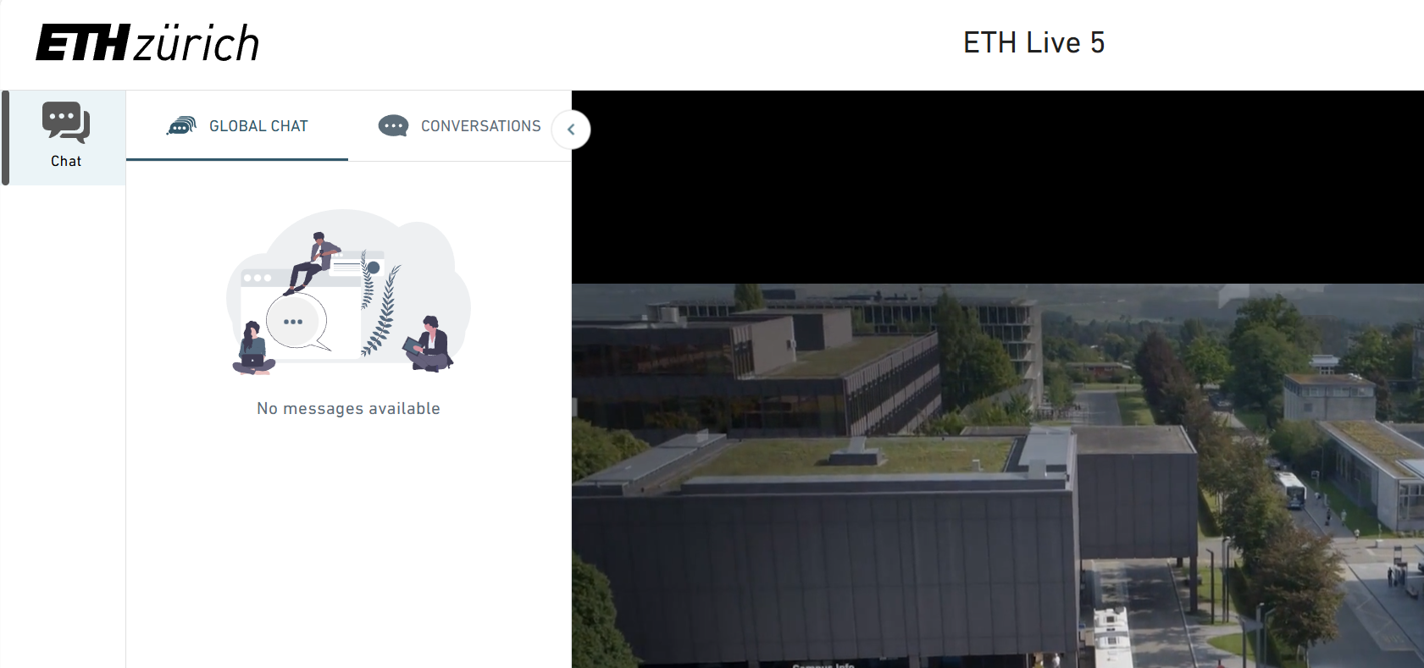
Online Participants

Slide 3
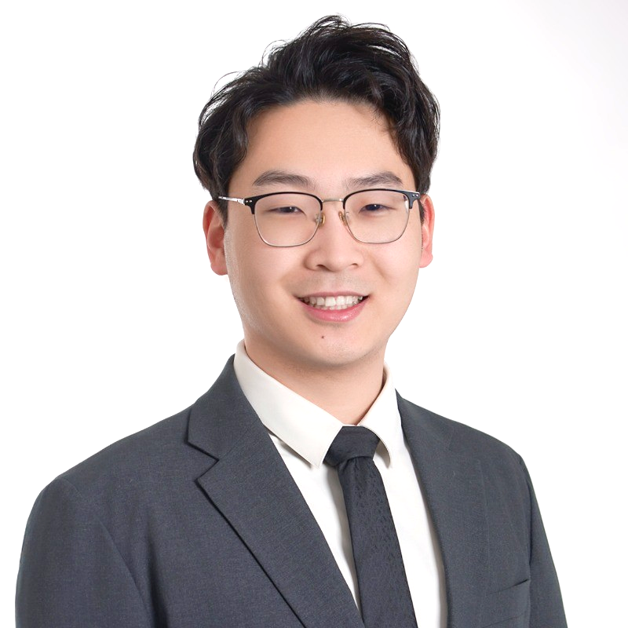
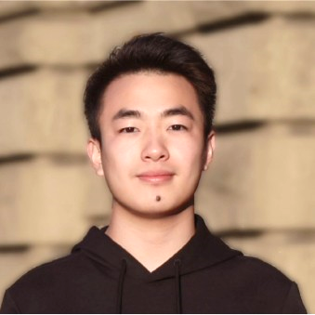
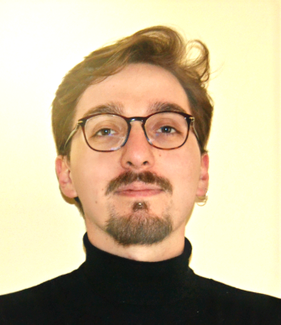
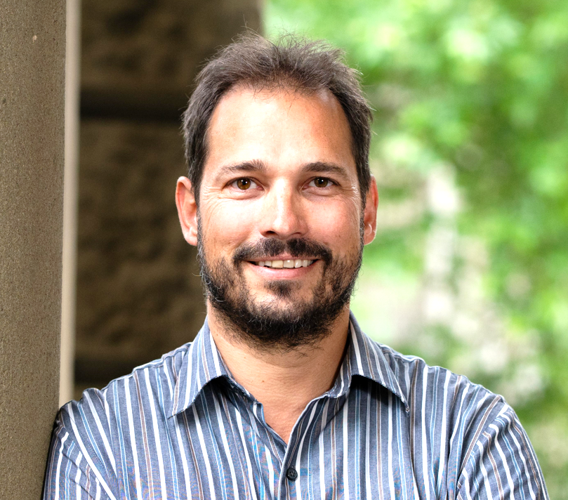
Organizing Team
Prof. Dr. Dachuan Zhang Shuntian Wang Dr. Giuseppe Cecere Prof. Dr. Stephan Pfister

Slide 4
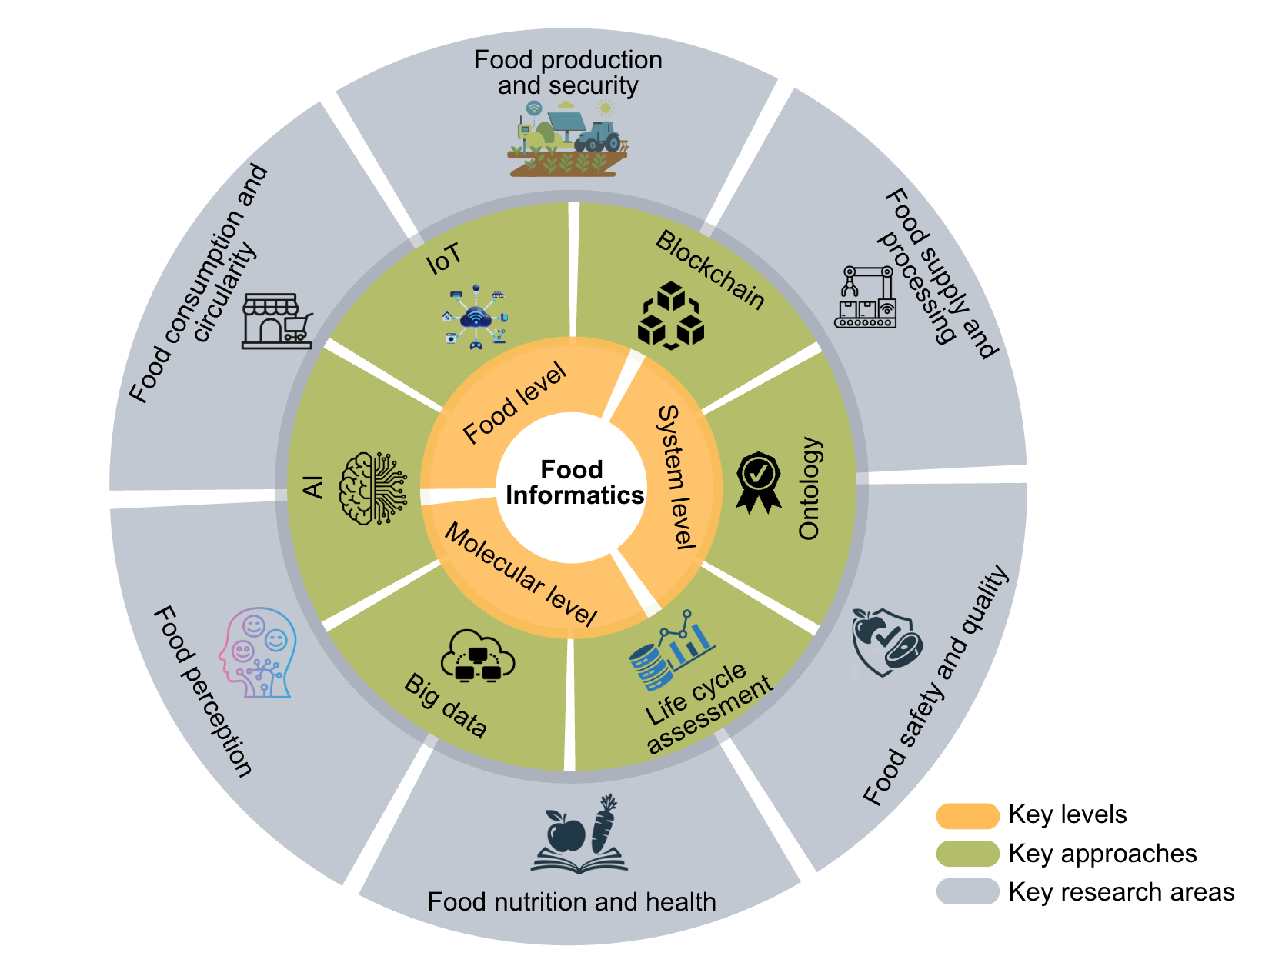

Dachuan Zhang Assistant Professor, National University of Singapore
Current main interests:
AI and its application in agri-food systems
(studies on molecular, food, and systems levels)
Predictive life cycle assessment, incl LCIA and LCA
Sustainable food and processing

Slide 5
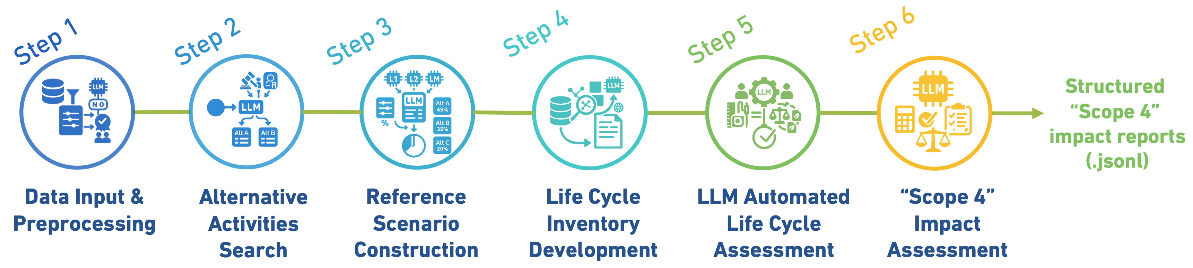
Shuntian Wang PhD Candidate in Environmental Engineering at ETH Zurich, supervised by Prof. Dr. Stephan Pfister
Current Main Interests
Agentic LLM workflows for creation, validation, and interpretation of LCA reports
Using AI to detect deficiencies, inconsistencies in corporate environmental disclosures
Applying AI-assisted methods to quantify environmental impacts in the agri-food sectors
Example: LLM based framework in measuring "Scope 4" impacts

Slide 6


Dr. Giuseppe Cecere Social LCA Senior Analyst, Ecoinnovazione SRL Spin-off ENEA
Current main interests:
Generative AI – Impacts on Life Cycle Assessment, Life Cycle Inivitative
Social LCA, Life Cycle Sustainability Assessment and AI
Social LCA Applied to Emerging Energy Technologies
AI and Databases: how AI will influence the development of Social LCA datasets

Slide 7
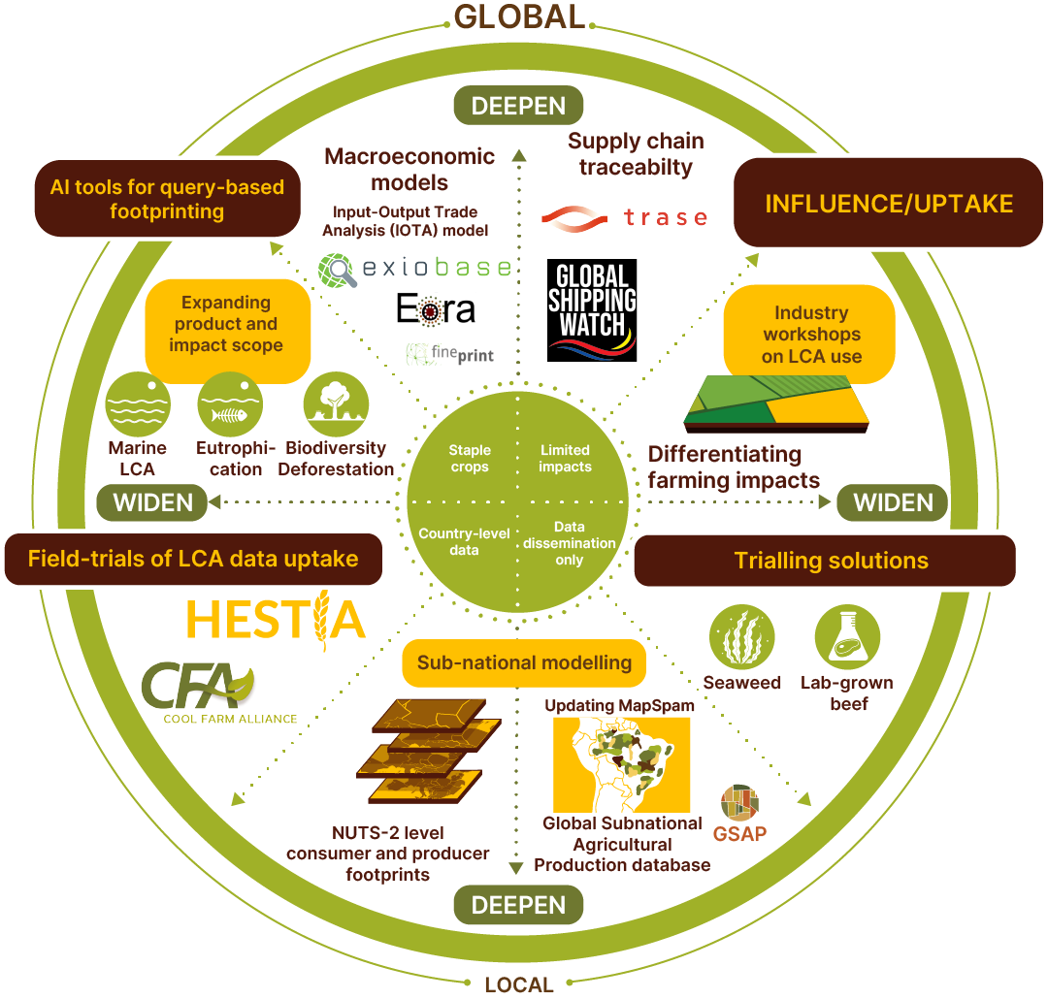


Stephan Pfister Professor for Quantitative Sustainability Assessment, ETH
Current Main interests:
Project on AI and Scope 4 (Shuntian’s project)
AI assisted LCAs
EU Project: GREENGROCER:
Develop Food database and AI assisted LCA tools
Use of AI for data creation
Details: https://greengrocer.nilu.no/project/about
AI and Teaching
What should students learn
How to teach them

Slide 8
What we address today - morning
AI general Challenge and use in LCA | [Giuseppe Cecere]
Lessons learned from ACLCA workshop on AI in LCA | Sangwon Suh, Tsinghua University*
Artificial intelligence in LCA: technical, ethical, and organizational reflections (UNEP Life Cycle Initiative) | Manish Kumar, KIT
AI in Daily LCA Consulting Practice: Opportunities, Risks, and Practical Applications | Niels Jungbluth, ESU-services
Discussion
Coffee Break
LCI Data modeling | [Dachuan Zhang]
AI-assisted LCA database development: the TianGong experience | Ming Xu, Tsinghua University*
LCA Data Quality and the Advent of Artificial Intelligence | Achille Laurent, ecoinvent
Why AI will never predict environmental impacts only from the molecular structure of a product and how we can still do it | Tim Langhorst, Carbon Minds
Machine Learning and AI for building stock models | Deepika Raghu, ETH
Discussion
Lunch Break

Slide 9
What we address today - afternoon
Short presentations | [Shuntian Wang]
EcoSemantic, the First AI-Native Platform for Sustainability Analysis | Carlos Gaete, EcoSemantic *
Structured evaluation process for assessing LLM quality performance in a LCA context | Julien Pedneault / Laure Patouillard, CIRAIG*
AI for assessing biochar application | Maria Myridanis, ETH
Beyond LCI and LCIA | [Dachuan Zhang]
Utilizing AI for S-LCA | Carolyn Cole, VTT*
AI-powered tool for footprinting | Christie Walker / Jakob Tresch, Niatsu
AI-Powered Product Lifecycle Intelligence | Fabian Hassel, Makersite*
Discussion
Coffee break
Break out discussions | [Stephan Pfister]
Wrap up of AI DF and Outlook to Automation DF | Stephan Pfister
Farewell | Dachuan Zhang
End of 92nd LCA Forum

Slide 10
Have a insightful day on LCA & AI!
Artificial Intelligence
Academic Innovation
Application in Industry
Ad Interim Knowledge
Sponsors 2026

Slide 11
WLAN
Network: Diskussionsforum
Password: DF-LCA-92

Slide 12
Synthesis

Slide 13
Breakout group discussions
Split into 3 groups in presence (plus one online)
Split into 2 sub groups:
Topic 1: Current use cases and limitations
Topic 2: Long-term opportunities and risks
Discuss for 25 minutes until 16.15
Report back and discuss for 10 minutes until 16.25
Come back to Plenum and report by all groups until 16.35
Synthesising outcomes until 16.55

Slide 14
Topics & Leading questions
Topic 1: Current use cases and limitations
In which phases of LCA can AI generate the greatest added value? (Goal & Scope, LCI, LCIA, Interpretation)
Can AI improve data quality, or does it risk amplifying uncertainty and bias?
Does automation of inventory modelling reduce expert control or enhance it?
How does the concept of data representativeness (temporal, geographical, technological) change in an AI-driven context?
Are AI tools fully compatible with ISO 14040/44 standards? To what extent?
Can reviews mainly be done by AI
What about IP and data rights
Is it important to standardize the types of support that AI can provide within life cycle assessment methodologies?
How can AI be smoothly integrated with existing LCA software, databases, and enterprise data systems (instead of becoming an additional step)?
Which tasks does AI perform well, and which are clearly unsuitable for it? What basic training do users (non-experts) need?
Topic 2: Long-term opportunities and risks
Will increasing reliance on AI reduce methodological transparency and scientific accountability in LCA?
How do we prevent bias embedded in databases from being amplified by AI?
How can standards (e.g., ISO frameworks) evolve fast enough to regulate AI-enhanced LCA?
Could AI-driven simplification lead to overconfidence in results and misuse in policy or marketing?
Can mass-produced LCAs “destroy” the domain and credibility
How can continuous updates and quality control be maintained as models, databases, and backend systems keep changing?

Slide 15
Synthesis

Slide 17

https://www.swiss-ai.org/

