Slide 1
AI-Powered Product Lifecycle Intelligence
92nd LCA Discussion Forum AI in LCA: Innovations, Applications, and Challenges

Slide 2

Data intelligence, the core of it all
Decision-grade data:
What it takes to operationalize LCA at scale
Notes:
Transition can also be covered by Makersite, not only at transparency phase - Maybe sales story telling

Slide 3

Data intelligence, the core of it all
How to build trust in technology?
Let’s understand it!
Notes:
Transition can also be covered by Makersite, not only at transparency phase - Maybe sales story telling

Slide 4
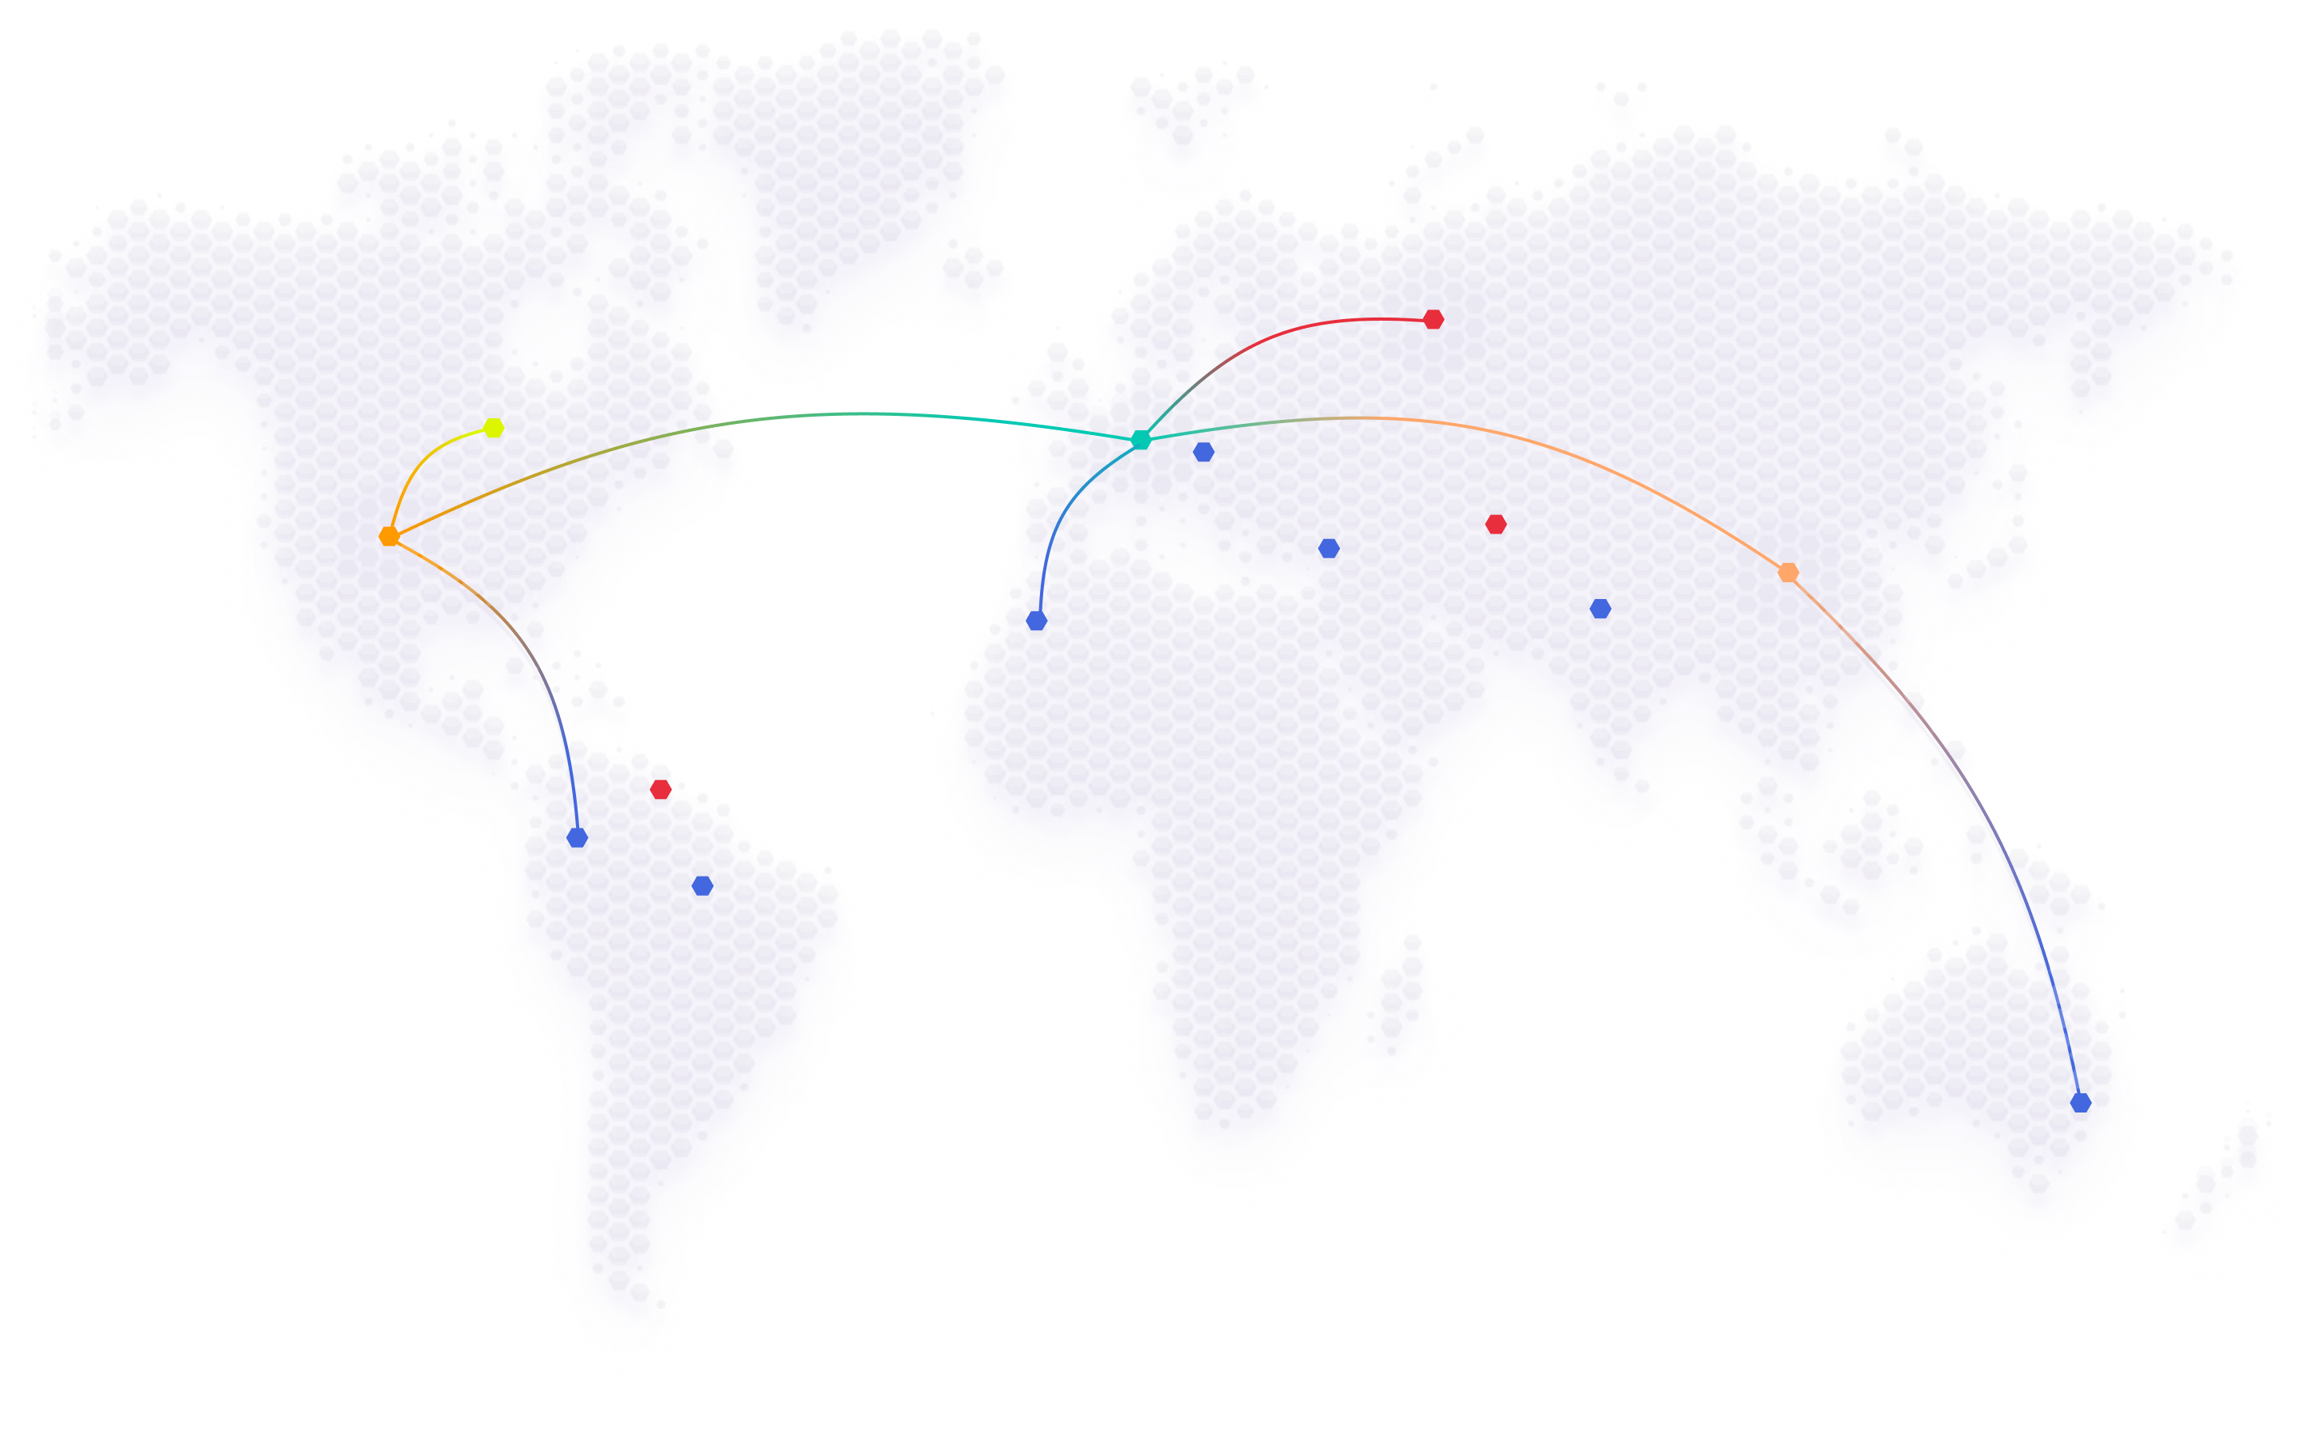

Documented
Traceable
Precision
Transparent
Confidence

Slide 5

Why are we
stopping
progress?

Slide 6
Makersite

