Slide 1
AI in LCA Consulting Practice
Opportunities, Practical Applications and Risks
Niels Jungbluth, Angelo Stefanel, Christoph Meili, Maresa Bussa, Martin Ulrich
https://esu-services.ch
info@esu-services.ch
92nd Discussion Forum on LCA: “AI in LCA: Innovations, Applications, and Challenges”
Thursday, 26nd of February 2026, Zurich, Switzerland
Notes:
Fokus auf was wir ESU konkret machen
Unsere Erfahrungen aufzeigen
Author
Niels Jungbluth, ESU-services GmbH tel +41 1 940 61 32 https://esu-services.ch, mailto:jungbluth@esu-services.ch

Slide 2






We assist you
Niels Jungbluth
Angelo Stefanel
Christoph Meili
Maresa Bussa
Martin Ulrich
Clients from industry, NGOs, administration, universities
Company database with more than 10’000 datasets
25+ years and 450 projects experience in life cycle assessment
All economic sectors covered
Founded 1998 @ETHZ
Notes:
Founded in 1998 as an ETHZ spin-off
USP: life cycle assessment (LCA)
Experienced co-workers
Long time experience in LCA since 1994
Clients from industry, NGO, administration, universities
Own LCA database with more than 10‘000 datasets

Slide 3
We provide…
Consulting
Case studies on LCAs, OLCA, CF, EPD & PEF (compliant with different standards)
Tools
LCA software SimaPro resale, automation, key parameter models
Databases and single datasets (data-on-demand)
Expertise
Training & coaching
Critical peer reviews, verification & validation

Slide 4

Introduction: Why Now?
Context for the audience:
AI is changing science and industry, LCA is affected
More LCI data, complex models, and shorter project cycles increase pressure
AI tools (ML, NLP, LLMs) can support LCI data handling, modelling, and reporting
At the same time, they raise questions regarding transparency, traceability, and quality in line with ISO 14040/44
ESU-services’ positioning:
Focus on scientific quality, transparency, and reproducibility
Use AI carefully without compromising core LCA principles
Notes:
ML (Machine Learning) Machine Learning ist ein Teilbereich der KI, bei dem Systeme aus Daten lernen und Muster erkennen, ohne explizit programmiert zu sein.
🔹 NLP (Natural Language Processing) Natural Language Processing ist ein Bereich von ML/KI, der sich mit dem Verstehen und Verarbeiten menschlicher Sprache beschäftigt.
🔹 LLM (Large Language Model) Ein Large Language Model ist ein sehr großes Sprachmodell, das auf riesigen Textmengen trainiert wurde und Texte verstehen sowie generieren kann.
Increasing complexity includes:
More detailed foreground systems
Larger background databases
More scenario and sensitivity analyses
Consulting projects face tighter timelines while still requiring full documentation and critical review readiness.
AI can support tasks such as:
Data extraction from technical documents and EPDs
Structuring inventory data
Drafting report sections
However, methodological decisions (e.g., allocation rules, system boundaries, data quality assessment) must remain transparent and expert-driven.
The objective is not automation for its own sake, but meaningful support for high-quality LCA work.

Slide 5




What we use
Copilot
Le Chat
Perplexity
Custom made AI matching tool

Slide 6
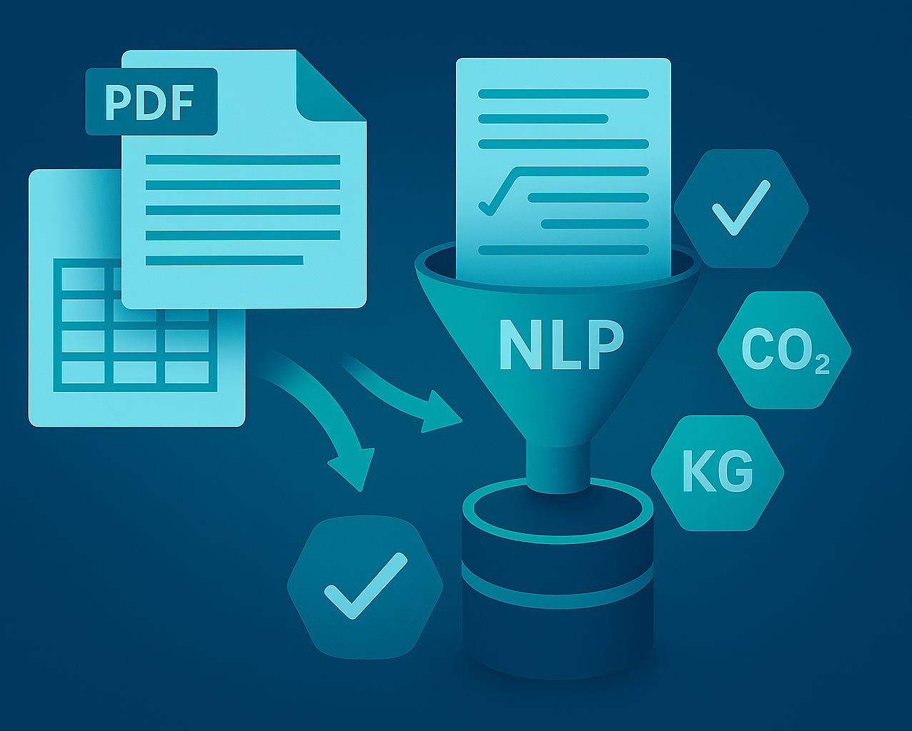
Practical Applications — Examples LCI modelling
Data Extraction & Harmonization
Search for information under certain boundaries
Automatic reading of PDFs/Excel sheets with material and energy data
Translation and search in all languages, e.g. Chinese
Identification of inventory gaps
Dataset Matching (LCI)
AI suggests suitable background datasets for inventory lists (BOM)
Matching of elementary flows in different nomenclatures
Page 6
https://esu-services.ch
Notes:
AI helps structure foreground and background data quickly, reducing repetitive work.
Classification ensures LCI data fits into ISO-compliant inventory models.
Drafted reports are starting points; experts refine for accuracy and completeness.
Main benefit: less time spent on data wrangling and report drafting, more on critical interpretation and decision-making.

Slide 7

Practical Applications — Examples from LCIA and interpretation
Hotspot Analysis
Rapid risk and sensitivity analyses in early project phases
Idea what needs to be considered in an LCA model
Support for prioritizing data collection efforts
Preparation of Reports, Summaries, Webpages
LLMs draft abstracts, translations, method chapters, system boundaries, stakeholder texts
Internal review of text and emails to ensures quality
Page 7
https://esu-services.ch
Notes:
Hotspot analysis identifies high-impact processes early, guiding efficient data collection.
Dataset matching reduces manual effort in mapping foreground flows to background data, increasing consistency.
AI-assisted reviews provide a first-pass check, highlighting inconsistencies or gaps before expert evaluation.
Experts remain responsible for final validation — AI is a time-saving support tool, not a substitute for review.
3.6 AI supports reviewers by running structured checklists against ISO 14040/44, scanning models for inconsistencies (units, allocations, cut‑offs), and reproducing key results to verify stability. It flags potential issues with confidence scores and suggested remedies, compiles an audit pack (logs, versions, parameter snapshots), and benchmarks against comparable studies. Experts remain responsible for interpretation and final judgments; sensitive client data is handled only on secure, compliant platforms.

Slide 8
Practical Applications — Review, Verification, Quality checks
LCA Reviews and validation of data
Early checks of assumptions
Internal quality checks
Benchmarking of LCA results even if different reference units are used
Accelerates pre-reviews and critical reviews (ISO 14040/44)
Supports EPD verification
Work through checklists
Page 8
https://esu-services.ch
Notes:
Automated checks for completeness, units, and plausibility

Slide 9

Practical Applications — daily office work
Contract negotiations
Legal support and understanding of documents
Explanation and understanding of out-of-subject information
Programming of Macros
IT Infrastructure operation and server setup
Email communication
Page 9
https://esu-services.ch

Slide 10

Risks & Challenges
Transparency & Traceability
Many models (especially LLMs) are black boxes.
Limited explainability → risk of silent errors.
Hallucination and providing complete nonsense information
Data Quality & Bias
AI can amplify errors or outdated information present in training data e.g. EPDs
Quality varies by region/industry → risk of misinterpretation
Page 10
https://esu-services.ch

Slide 11
Risks & Challenges
Reproducibility
Many AI models are non-deterministic → challenges for review and revision
LCA projects must remain fully reviewable
Much higher efforts for quality control
Copyright & Data Security
Unclear legal status of uploaded and provided information
Sensitive client data must stay secure
Use privacy-compliant platforms only
Risk of own transparent webpage becoming a competition to own business, risk for open-source policy
Environmental impact and social issues
Huge energy use. Will there be a real efficiency gain
People get too lazy to think on their own
Page 11
https://esu-services.ch
Notes:
Non-deterministic AI outputs can make it hard to reproduce past LCA results or respond to review questions.
Maintaining traceable workflows is critical for ISO 14040/44 compliance.
Legal and IP issues: uploaded documents may contain copyrighted or confidential data.
Open-source or public sharing may unintentionally expose business-sensitive methods or data.
Key point: AI must be integrated without compromising client confidentiality or LCA transparency.

Slide 12
Where do we have main benefits today?
Replacement of google search for more complex questions
Quick checks, sum-up or benchmarking
Verificaton/Review: Pre-checks for documentation and extension of feedback
Discussion and understanding of legal documents with clear prompts for checking
Matching of process names and elementary flows
Help for programming of Macros/VBA code/IT setup
Professional email communication on difficult issues

Slide 13
What does not work for us so far?
Identifiying gaps, not documented in public information
Risk of wrong contents or wording in texts, accepting haluzination
More concentration and efforts necessary on re-checking the outcome wording and documentation (everything sounds nice)
Risk to accept wrong recommendations
Language is not concise and specific enough, to generic textes
Custom-made development slower than progress in public models (difficult to plan investments)
Communication based on AI, but diverging goals – AI talks to AI without solution
Increased experience necessary to handle the complexity, overload for beginners

Slide 14
ESU‑services’ internal AI Guidelines for good LCA Practice
Safeguards
Clear delineation and ongoing discussion at ESU:
-What may AI automate?
-What remains human expert work?
Transparency Principle
Document every AI‑assisted decision and information (similar to assumptions and sources)
Reproducibility & Reviewability
AI outputs must be traceable. Ask for links or references
New chats for each relevant discussion
Save prompts for documentation and reuse
Human‑in‑the‑Loop
Prompts development ensuring critical discussion
Expert validation remains mandatory
AI is a tool, not a decision‑maker
Page 14
https://esu-services.ch

Slide 15

Copyright notice
All rights reserved. The contents of this presentation (a. o. texts, graphics, photos, logos etc.) and the presentation itself are protected by copyright. They have been prepared by ESU-services Ltd.. Any distribution or presentation of the content is prohibited without prior written consent by ESU-services Ltd.. Without the written authorization by ESU-services Ltd. this document and/or parts thereof must not be distributed, modified, published, translated or reproduced, neither in form of photocopies, microfilming nor other – especially electronic – processes. This provision also covers the inclusion into or the evaluation by databases.
Permitted is the use of contents published on our webpage according to scientific standards (small parts copied or cited with clear citation given to the webpage were downloaded).
Contraventions will entail legal prosecution.
In case of any questions, please contact:
Dr. Niels Jungbluth, CEO - Chief Executive Officer
ESU-services Ltd. - fair consulting in sustainability
Vorstadt 10
CH-8200 Schaffhausen https://esu-services.ch
tel +41 44 940 61 32
jungbluth@esu-services.ch
© Copyright ESU-services Ltd. 26.02.2026

